Slide 1

Psychophysics of the basic sound dimensions: Pitch

Slide 2
Pitch
ANSI (1973): "that attribute of auditory sensation in terms of which sounds may be ordered on a scale extending from low to high"
Plack (2005): “The aspect of auditory sensation whose variation is associated with musical melodies”
F0 frequency
pitch
periodicity
pitch

Slide 3
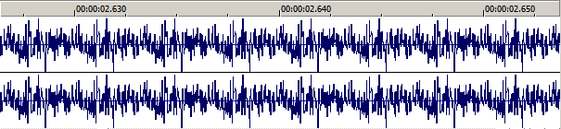
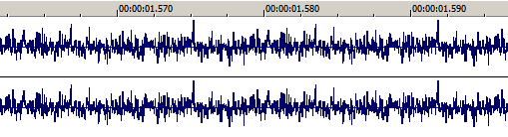
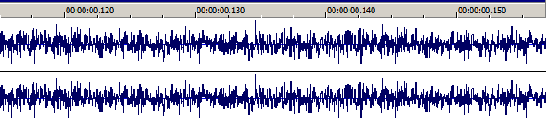
Pitch from a noisy source?
Listen to them, get pitch sensations...
... and then look at the waveforms!!!

Slide 4
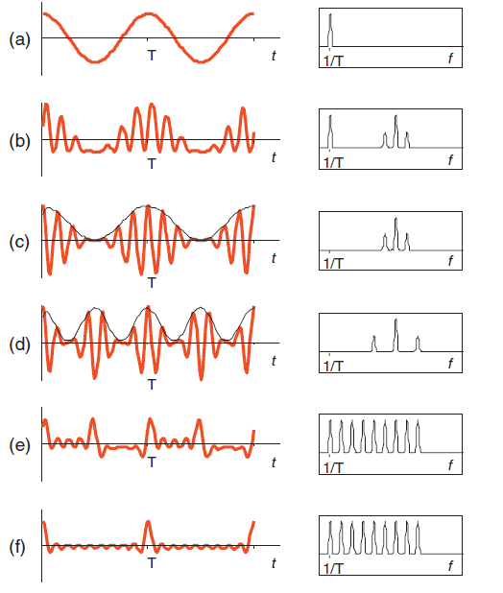
Pitch: different waves, diferent spectra...
... But the same pitch sensation!!!!
And even without a fundamental in the spectrum!!!
(cases c and d)

Slide 5
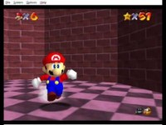
Pitch ascending endlessly?
Sheppard
Tones
http://fallingfalling.com/

Slide 6
Frequency perception: absolute thresholds
20Hz – 20kHz (in young, intact hearing systems, 16kHz in adults)
HF threshold permanent decrease due to:
Ototoxic substances: aspirin, quinine
Exposition to high levels of sound pressure (>85dBSPL) for long periods of time

Slide 7
Head size (cochlear volume) and threshold for frequency

Slide 8
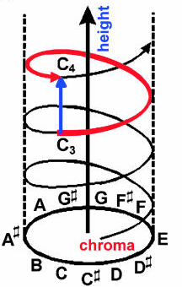
Dimensions of the pitch sensation: chroma and height
Tones are judged to be more similar when they share “chroma” (just up to 5 kHz)
Tones are ordered in a spatial way (height) from low to high
Shepard’s helix model: pitch height and chroma

Slide 9
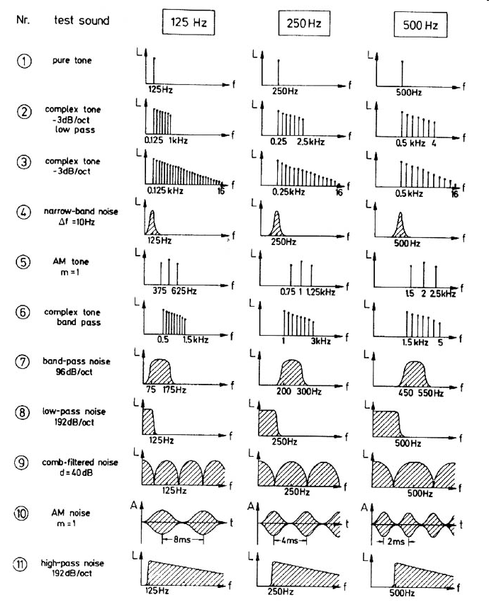
Dimensions of the pitch sensation: strength
determined by:
the microstructure of the waveform (the simpler, the strongest pitch)
the amplitude envelope (random-phase -> weak pitch)

Slide 10
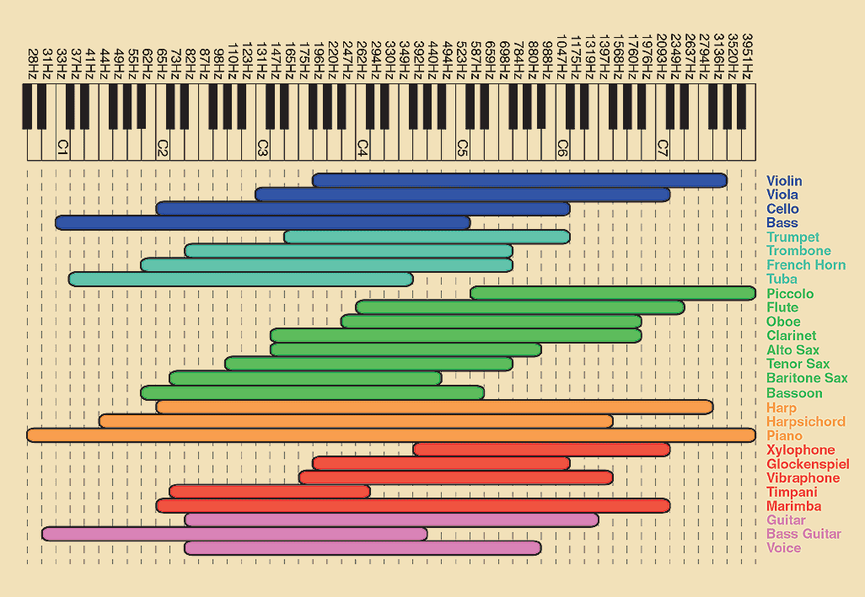
Pitch sensation thresholds
Region for pitch:
30Hz-5000Hz
Highest piccolo note: 4500Hz
Is there any chance for high-frequency music?

Slide 11
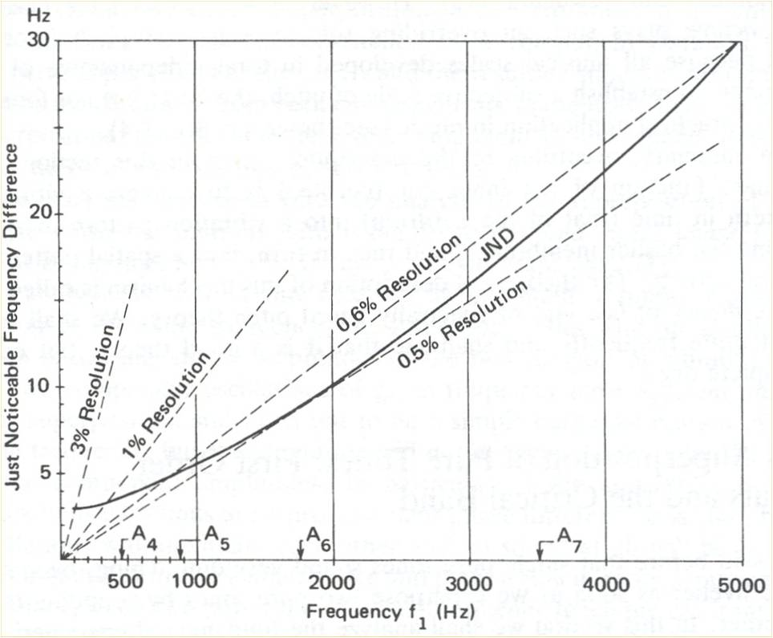

Pitch differential threshold (JND)
HF tones: 0.5% of the base frequency; <10 cents
LF tones: better than 3% and around 2 or 3Hz; ~40 cents
MF tones: ~4 cents
Cents = 1200 log2[(f2)/f(1)]

Slide 12
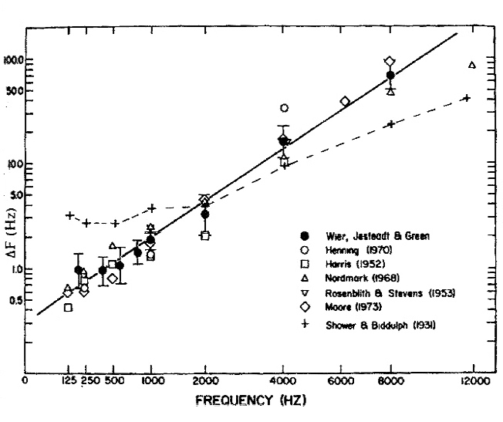
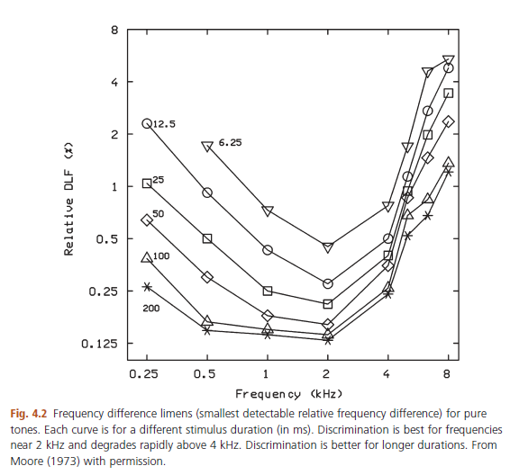
Pitch differential threshold (JND)
HF tones: <10 cents
LF tones: ~40 cents
MF tones: ~4 cents
Cents = 1200 log2[(f2)/f(1)]
Why not using more “notes” in music? (as we can hear >100 “notes” between A440 and A880)

Slide 13
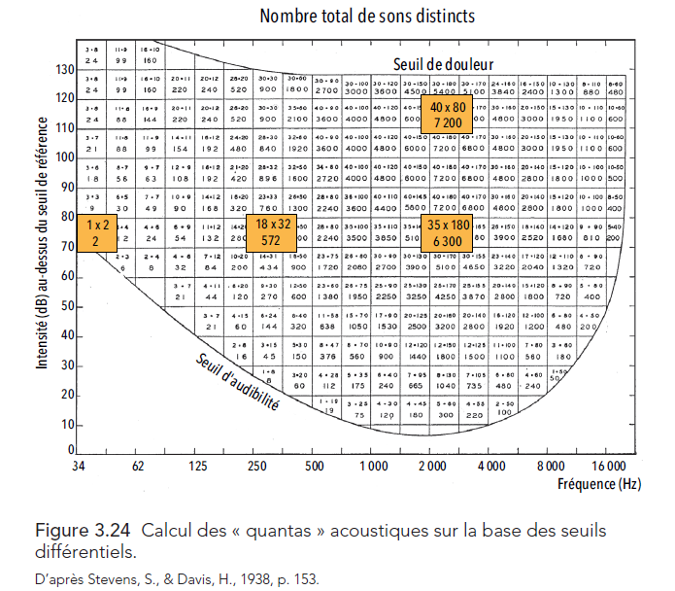
Perceivable “Quanta”
How many different “sounds” can we perceive (considering loudness JND & pitch JND)

Slide 14
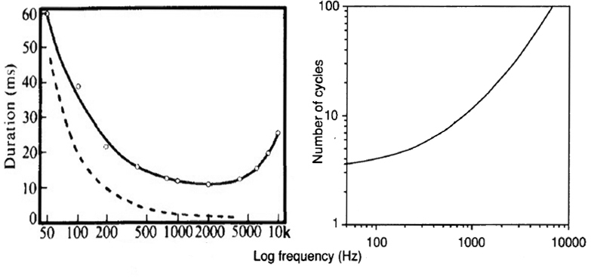
Duration effects on pitch
Minum cycles or minimum duration?

Slide 15
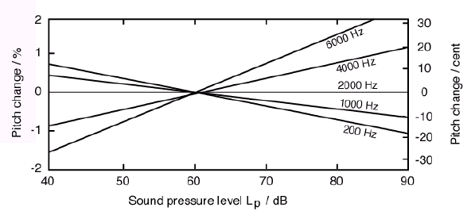
Intensity effects on pitch

Slide 16
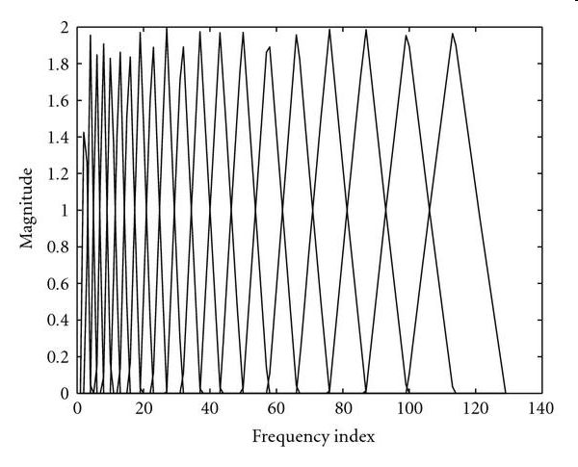
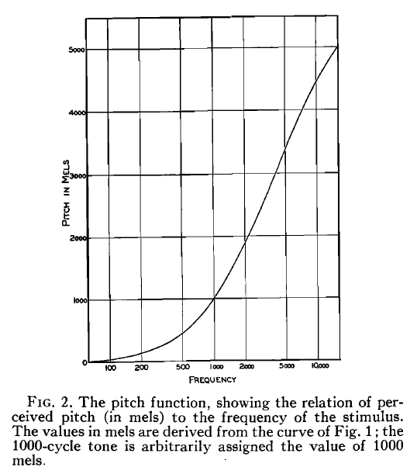
Subjective scale for pitch: Mel
How far in frequency do we have to be in order to feel a tone as doubled in pitch?
m = 1127 ln (1 + f / 700)
8kHz=2840mel / 500Hz=607mel
f = 700 [exp(m / 1127) - 1]
Mel-scaling is used in signal processing to build filters that approximate our frequency resolution (MFCC)!!!
Mel filters

Slide 17
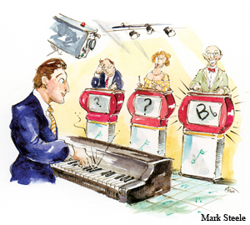
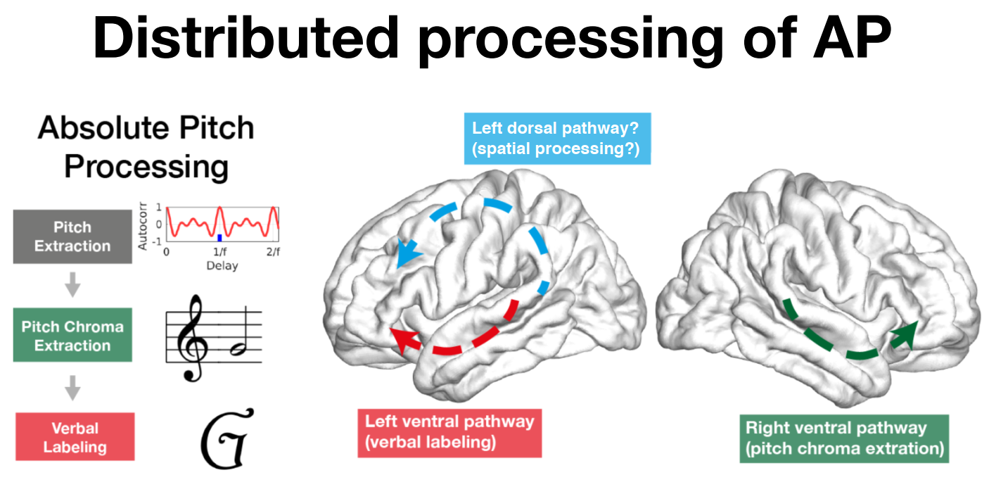
Absolute pitch

Slide 18
Absolute pitch
The ability to name a sounded pitch or to produce a pitch in response to a note name.
Possessors of AP name pitches rapidly and without effort or conscious strategy
It is contrasted with relative pitch (RP), the ability to identify notes relative to sounded reference pitch(es)
Pitch memory equal for possessors and nonpossessors of AP for delays up to one minute, but only AP possessors perform above chance for longer delays
Various findings implicate verbal codes
AP can be learned most easily during a limited period of development, possibly comparable to a critical period for language learning
AP involves several neurally separate subprocesses (pitch perception, classification, labelling, storage in long-term memory, retrieval from memory)

Slide 19
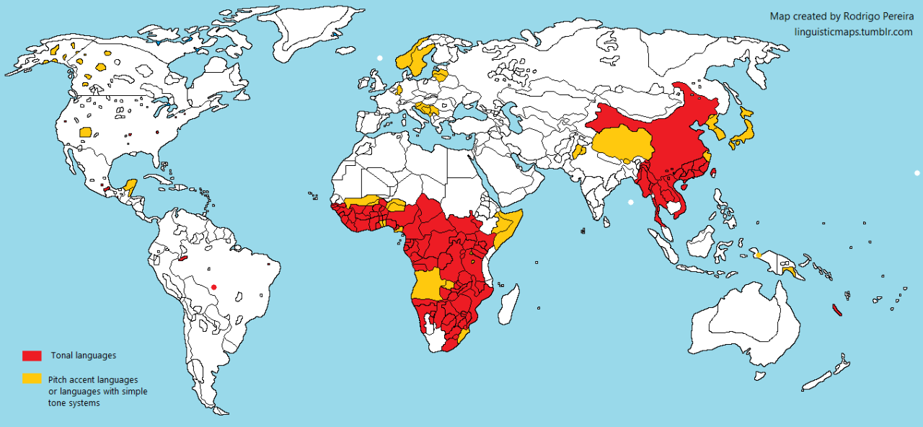
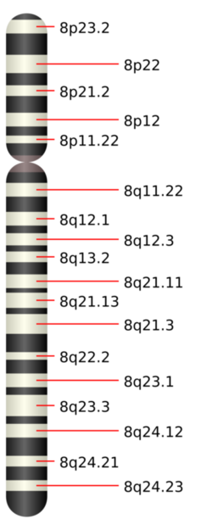
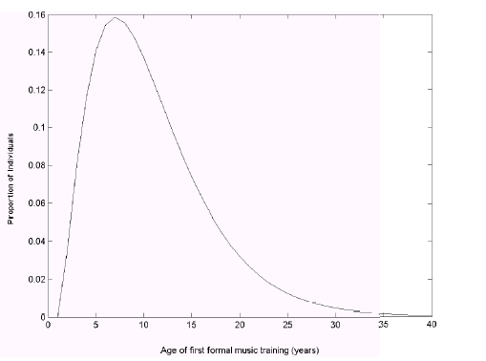
Absolute pitch
Chromosome 8

Slide 20
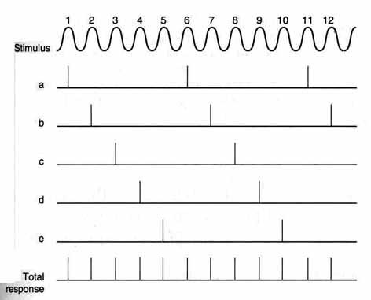
Mechanisms for the pitch sensation of pure tones
Place theories
Place of maximum in basilar membrane excitation (excitation pattern)
- which fibers are excited?
Timing theories
Temporal pattern of firing
- how are the fibers firing?
- needs phase locking

Slide 21
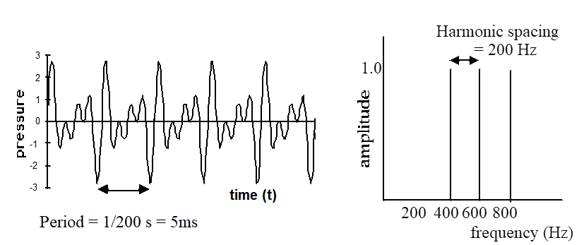
Place theory and the missing fundamental
The pitch of a tone having partials at 300, 400, 500 and 600 Hz will be 100Hz
… even though there is no energy present there!!!
How do we properly track the bass F0 from small radio tuners, small headphones and small loudspeakers?

Slide 22
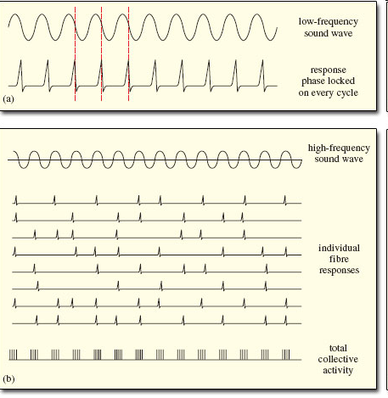
Timing theory: Phase-locking
1
0
0
0.2
0.4
0.6
0.8
1
-0.5
-1
Response to Low Frequency tones
Inter-spike Intervals
2 periods
1 period
nerve spike
time (t)
Response to High Frequency tones > 5kHz
Random intervals
time (t)

Slide 23
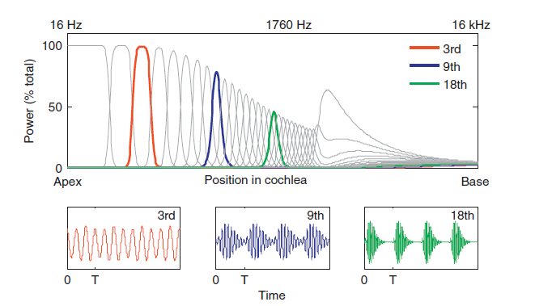
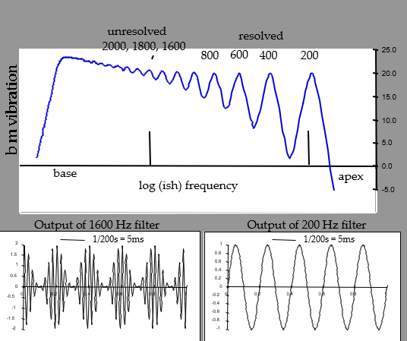
Timing theory: Unresolved harmonics in critical bands
Beating in HF auditory filters follows the periodicity of the “fundamental”

Slide 24
Two operating mechanisms
Place-based mechanism
Timing-based mechanism
Or maybe more?
Which pitch do you perceive here (401-602-840)?

Slide 25
Two complementary mechanisms: place + periodicity (based on Moore (1982)

